Slide 1
Unit 5 Organization Structure and Design

Slide 2
Learning Outcomes
Structure, Systems, Staffing models in operation strategy
How operations play a role in implementing change in organizations.

Slide 3
Organizational structure
The way in which job tasks are formally divided,
grouped, and coordinated.

Slide 4
Work Specialization
Early in the twentieth century, Henry Ford became rich by building automobiles on an assembly line.
Every Ford worker was assigned a specific, repetitive task such as putting on the right-front wheel or installing the right-front door.
By dividing jobs into small standardized tasks that could be performed over and over, Ford was able to produce a car every 10 seconds, using employees who had relatively limited skills.
Ford demonstrated that work can be performed more efficiently if employees are allowed to specialize.
Today, we use the term work specialization , or division of labor , to describe the degree to which activities in the organization are subdivided into separate jobs.

Slide 5
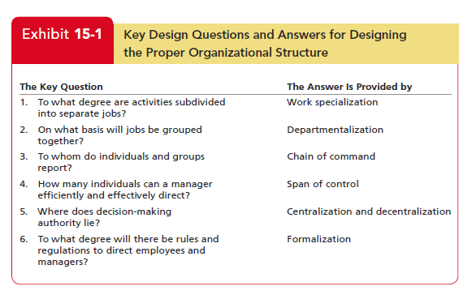

Slide 6
Departmentalization
Once jobs have been divided through work specialization, they must be grouped so common tasks can be coordinated.
The basis by which jobs are grouped is
called departmentalization .

Slide 7
Types of Departmentalization
By Function
Maruti Suzuki
By Product / Service
Procter & Gamble
By Geography Or Territory
Indian Railways
By Customer Segment
manufacturing
accounting
HR
supply departments
Tide
Pampers
Charmin
Pringles
Northern
Southern
Eastern
Western
Central
North-East
South-West ….
Microsoft
Consumers
software developers
small businesses
Large corporations.
engineering
Notes:
Each Product under under an executive who has complete global responsibility for it.
The major advantage here is increased accountability for
performance, because all activities related to a specific product or service are
under the direction of a single manager.
The major advantage here is increased accountability for
performance, because all activities related to a specific product or service are
under the direction of a single manager.

Slide 8
Common Organizational Designs
The Simple Structure
low degree of departmentalization
The Bureaucracy
Standardization
The Matrix
creates dual lines of authority and combines functional and product departmentalization
wide spans of control
authority centralized in a single person
little formalization
very formalized rules and regulations
tasks that are grouped into functional departments
narrow spans of control
centralized authority
Decision making that follows the chain of command.
Standard operating Procedures

Slide 9
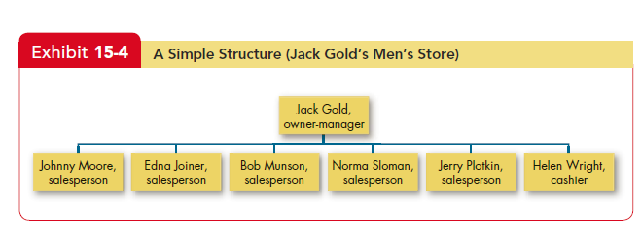

Slide 10
Bureaucracy : the flip side
ROLE PLAY :: 4 Actors
Production executive.
Research and development manager.
Marketing executive
Accounting manager
Notes:
“You know, nothing happens in this place until we produce something,” said the production executive.
“Wrong,” commented the research and development manager. “Nothing happens until we design something!
“What are you talking about?” asked the marketing executive. “Nothing happens here until we sell something!”
The exasperated accounting manager responded, “It doesn’t matter what you produce, design, or sell. No one knows what happens until we tally up the results!

Slide 11
Bureaucracy : the flip side
This conversation highlights that
bureaucratic specialization can create conflicts in which functional-unit goals override the overall goals of the organization.
obsessive concern with following the rules.
When cases don’t precisely fit the rules, there is no room for modification.
The bureaucracy is efficient only as long as employees confront familiar problems with programmed decision rules.

Slide 12
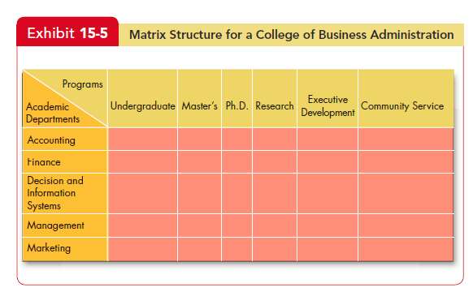

Slide 13
Test your understanding!
Q1: The degree to which activities within an organization are subdivided is known as:
Departmentalization
Divisioning
Formalization
Work Specialization

Slide 14
Test your Understanding!
Q2: In healthcare organization; which of the following departmentalization is found:
By function
By committee
Be geographical region

Slide 15
Revision Questions
Q1: Rigid departmentalization within an organization leads to:
Organic structure
Virtual structure
Geographic structure
Mechanistic approach

Slide 16
Revision Questions
Q2: In which of the following structure, each specialist is supposed to provide their functional advice to all other foreman and workers:
Line organization
Functional organization
Line and staff organization

Slide 17
Unit 5 : Organizational Conflict and Negotiation

Slide 18
Learning Outcomes
Differentiate among the traditional, interactionist and managed-conflict views of conflict.
Task, Process and Relationship conflict
Outline the conflict process.
Define negotiation.
Contrast distributive and integrative bargaining.

Slide 19
Introduction to Context
Write the definition of conflict. Define conflict without using negative terms.

Slide 20
Terminology
Conflict : A process that begins when one party perceives that another party has negatively affected, or is about to negatively affect, something that the first party cares about.
Dysfunctional Conflict : A conflict that hinders group performance is a destructive or dysfunctional conflict
Functional Conflict : supports the goals of the group and improves its performance
Negotiation : a process that occurs when two or more parties decide how to allocate scarce resources.

Slide 21
The Traditional View of Conflict
assumed all conflict was bad and to be avoided.
a dysfunctional outcome resulting from poor communication, a lack of openness and trust between people, and the failure of managers to be responsive to the needs and aspirations of their employees.
The Interactionist View of Conflict
The belief that conflict is not only a positive force in a group but also an absolute necessity for a group to perform effectively.
The interactionist view does not propose that all conflicts are good, but encourages functional conflict.

Slide 22
Resolution-Focused View of Conflict
Researchers, including those who had strongly advocated the interactionist view, have begun to recognize some problems with encouraging conflict.
In light of these findings, researchers have started to focus more on managing the whole context in which conflicts occur, both before and after the behavioral stage of conflict occurs.
A growing body of research, suggests we can minimize the negative effects of conflict by focusing on preparing people for conflicts, developing resolution strategies, and facilitating open discussion.

Slide 23
Sources of Conflict
Task conflict relates to the content and goals of the work.
Process conflict relates to how the work gets done.
Relationship conflict focuses on interpersonal relationships.
People can seldom wall off their feelings into neat categories of “task” or “relationship” disagreements, so task conflicts sometimes escalate into relationship conflicts.

Slide 24
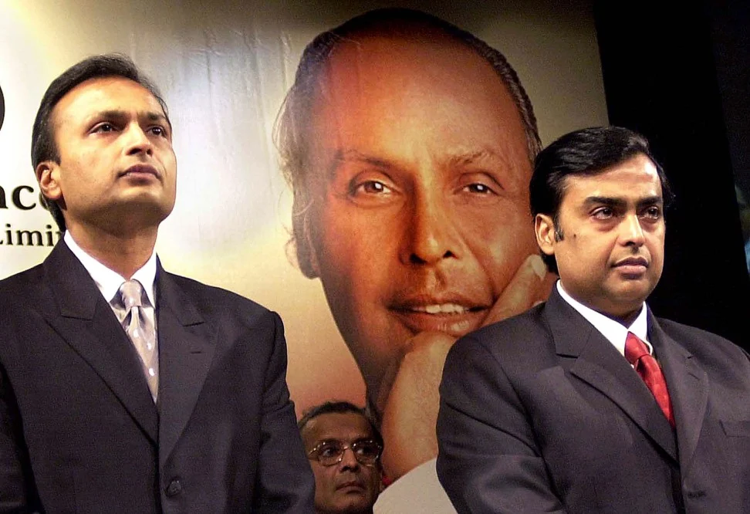

Slide 25
Mukesh Ambani vs Anil Ambani: India’s biggest sibling rivalry, ever?
While there may be just two years between them, Mukesh Ambani’s fortune massively outweighs that of his brother Anil. Older Mukesh, 62, is the richest man in Asia with roughly US$50 billion, according to Forbes’ real-time assessment.
Meanwhile the younger Anil – who was the world’s sixth richest person in 2008, with a reported net worth of US$42 billion – may not even be a billionaire any more, according to recent reports.

Slide 26
During their younger years, the brothers worked together at Reliance Industries under their father, Dhirubhai Ambani.
During this time, it was reported that the brothers displayed remarkable interpersonal chemistry, sometimes even finishing each other’s sentences.
It was a widely held belief that the two would eventually both take over Reliance Industries and run the business empire side by side.

Slide 27
In 2002, their self-made father, the founder of Reliance Industries, died of a stroke.
The complicated part? He hadn’t written up a will.
Naturally, the two brothers fought over their father’s sizeable fortune and massive corporate holdings.
Finally, Mukesh and Anil’s mother Kokilaben brokered an agreement for the brothers, demerging Reliance Industries.
Mukesh took over the oil and chemical portion of the company and Anil took over the electricity and telecom arm of things.

Slide 28
While Mukesh and Anil both had sizeable portions of Reliance under their control, they still disagreed time and time again.
In 2008 Anil sued Mukesh for defamation after he criticised Anil in The New York Times.
Anil also repeatedly blamed Mukesh for Reliance’s unpopular decisions, going so far as to take out an ad in The Times of India that criticised his brother for raising gas prices.
This culminated in a 2010 case between the brothers that went to the Supreme Court of India.
Once again, Mum came to the rescue and brokered a non-compete clause between the siblings so their business disagreements could cool down.

Slide 29
Almost a decade-and-a-half after a bitter separation, Mukesh Ambani on Monday stepped in to save younger brother Anil from prison by helping him clear the Rs 453 crore Reliance Communications owed Ericsson.

Slide 30
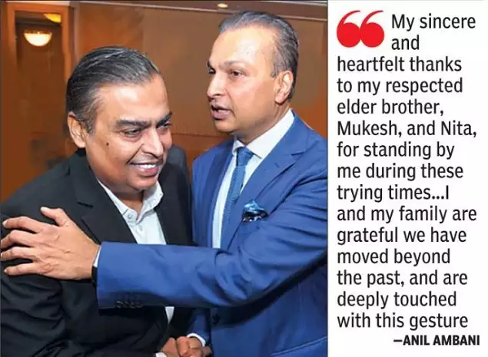

Slide 31
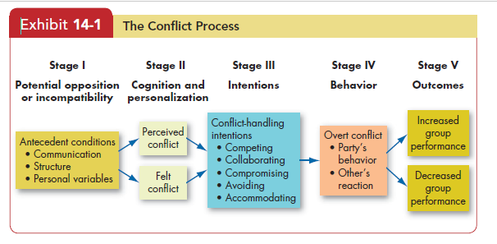
Process of Conflict / Stages

Slide 32
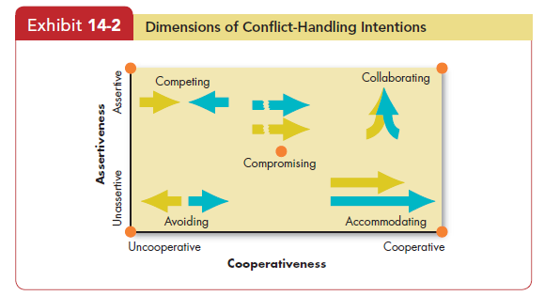

Slide 33
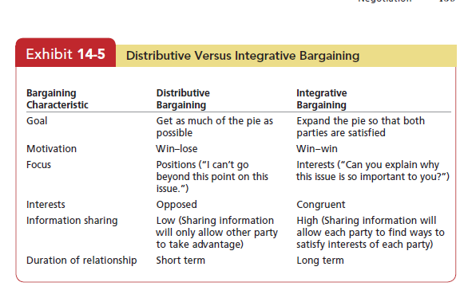

Slide 34
Revision Questions
Q5: Which departmentalization leads to the company’s product fall into several categories with very different production methods for each category?
Production
Customer
Process
Matrix

